Slide 1


SENTIMENT ANALYSIS OF MOVIE REVIEWS Submitted by: Prince Kumar (202410116100149) Neha Agnihotri(202410116100131) Samiksha Teotia (202410116100178) Rahul (202410116100157)

Slide 2
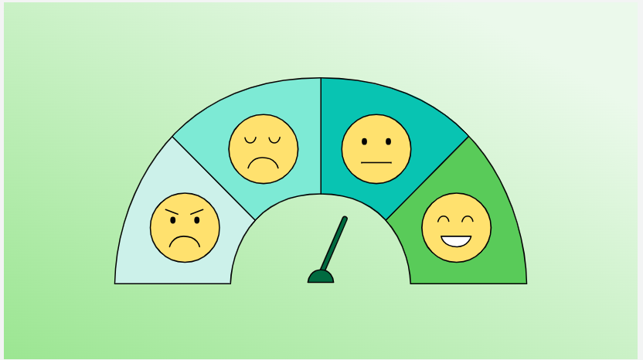

Agenda
INTRODUCTION
APPLICATION
WORK FLOW
TECHNIQUES
SAMPLE CODE
SCREENSHOTS
CHALLENGES
CONCLUSION

Slide 3
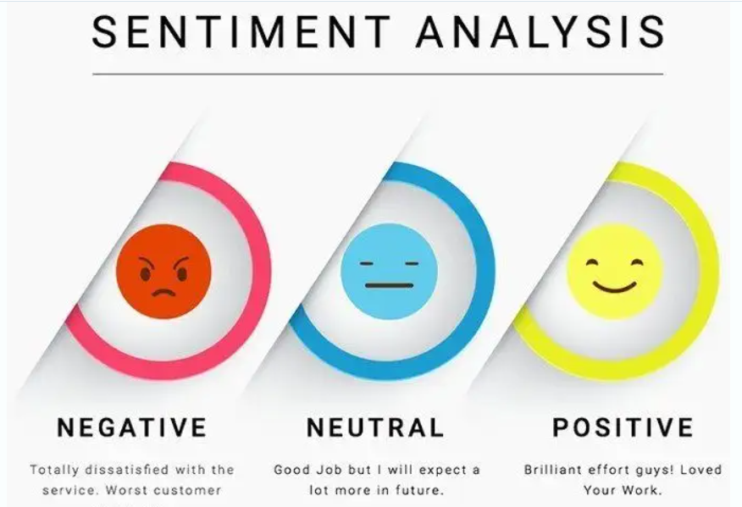

INTRODUCTION
A method to detect emotions in text
Also called opinion mining
Commonly used to classify text as:
Positive
Negative
Neutral

Slide 4
ANALYSIS OF MOVIE REVIEWS
Sentiment analysis is like teaching a computer to read people's comments, reviews, or posts — and understand how they feel about something.
Sentiment analysis, also known as opinion mining, is a natural language processing (NLP) technique used to determine the emotional tone behind a body of text.
In the context of movie reviews, sentiment analysis aims to automatically identify whether a review expresses a positive, negative, or neutral opinion about a film.
By using machine learning algorithms or deep learning models such as Naive Bayes, Support Vector Machines (SVM), or LSTM neural networks, systems can be trained to classify sentiments with high accuracy..

Slide 5
Applications of Sentiment Analysis in Movie Reviews
Audience Feedback Analysis Sentiment analysis helps movie producers and distributors understand how audiences are reacting to a movie.— such as the acting, storyline, direction, or music.
Movie Recommendation Systems Platforms like Netflix, Amazon Prime, and Disney+ use sentiment analysis to improve recommendations. If a user likes movies that get a lot of positive emotional feedback, the system can suggest similar films. This improves personalization and enhances user experience.
Box Office Prediction Before or shortly after a movie's release, early reviews and online discussions can be analyzed to predict how well a movie will perform. If sentiment is mostly positive, it’s likely to attract more viewers, which can indicate a higher box office return.
Marketing Strategy Optimization Studios monitor the audience’s reaction to trailers, posters, interviews, and promotional campaigns.
Competitor Analysis Sentiment analysis allows studios to compare how their movie is performing emotionally compared to competitors. For example, if two action movies release at the same time, comparing audience sentiments helps understand which one resonates more and why.

Slide 6


HOW IT WORKS..
1. COLLECTION REVIEWS: The first step is gathering text data — movie reviews in this case. Reviews can be collected from platforms like- google reviews, twitter.
2. TEXT PREPROCESSING : Before feeding the data to a model, it must be cleaned and standardized like- remove punctuation ,lowercasing.
3. FEATURE EXTRACTION : Since ML models can’t understand text directly, we convert it into numbers.
4. CLASSIFICATION: we train a Machine Learning or Deep Learning model like- naïve bayes , long short-term memory(handles sequence of words).
5. PREDICT SENTIMENT: Once trained, the model can predict the sentiment of new reviews:
"The movie was brilliant!" → Positive
"It was a waste of time." → Negative
"It was okay, not great but not bad either." → Neutral

Slide 7
TECHNIQUES
MACHINE LEARNING TECHNIQUES
Naive Bayes-A simple and fast algorithm based on probability.
Support Vector Machine (SVM)-A powerful classifier that tries to find the best boundary between different classes (e.g., positive vs. negative)
2. DEEP LEARNING TECHNIQUES
LSTM (Long Short-Term Memory)-Good at understanding sequences of words (like sentences)
Remembers long-term dependencies in text (e.g., “not good” vs. “good”)
CNN (Convolutional Neural Network)-Fast and efficient for sentence-level classification
BERT (Bidirectional Encoder Representations from Transformers) -Pre-trained model from Google

Slide 8
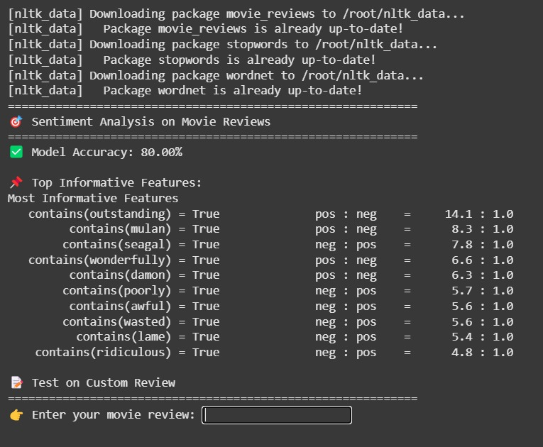
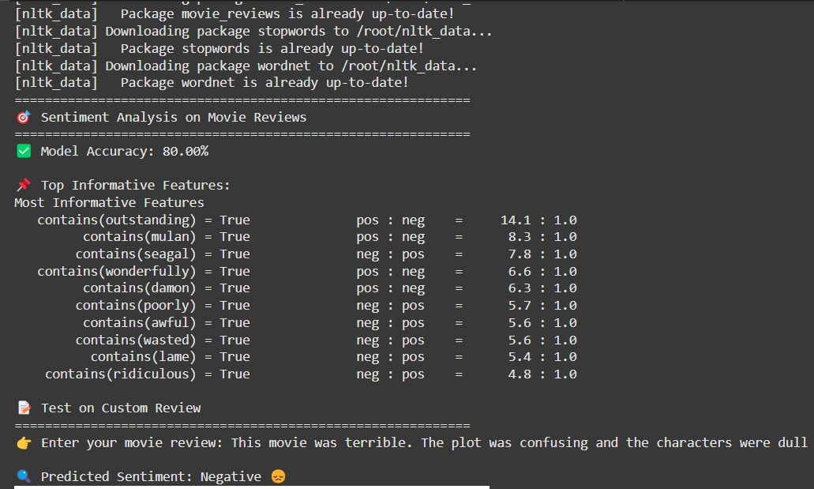
SCREENSHOTS..
Product launch
Successful introduction of our product to market
10,000 user milestone
Substantial user base, indicating growing demand
Strategic partnership
Expanding market presence and capabilities
Milestone | Quarter
Product launch | Q1
10,000 user milestone | Q2
Strategic partnership | Q3
Campaign launch | Q4

Slide 9
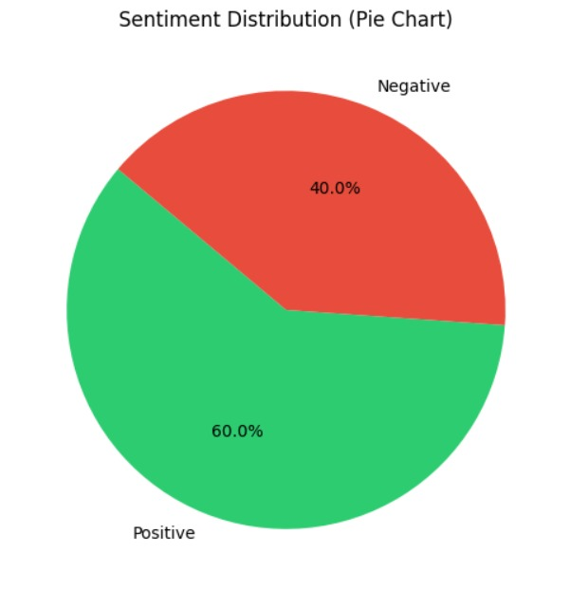
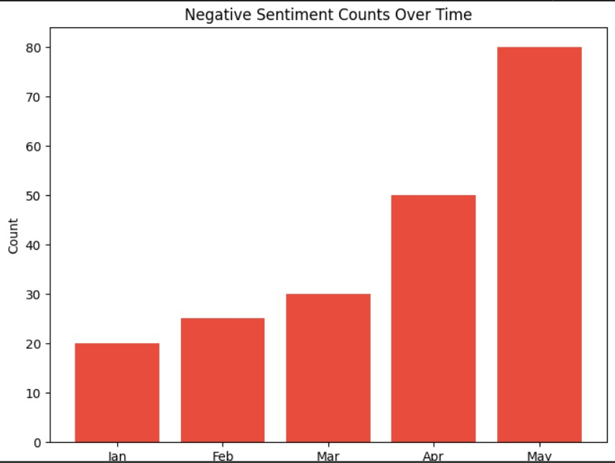
CHART ANALYSIS..

Slide 10
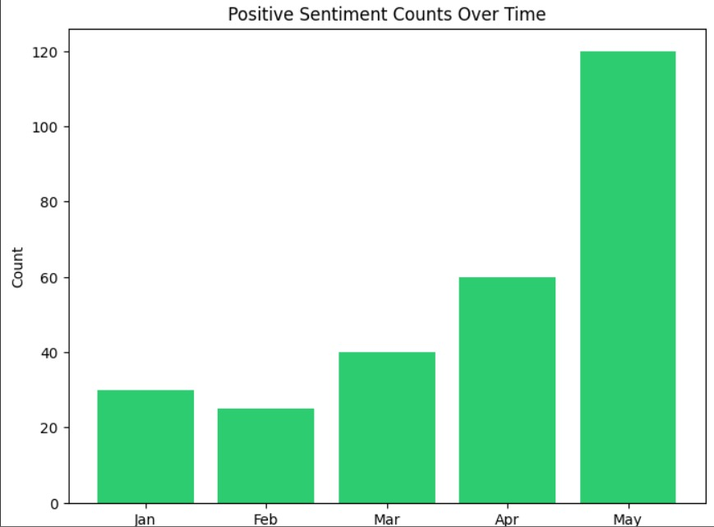
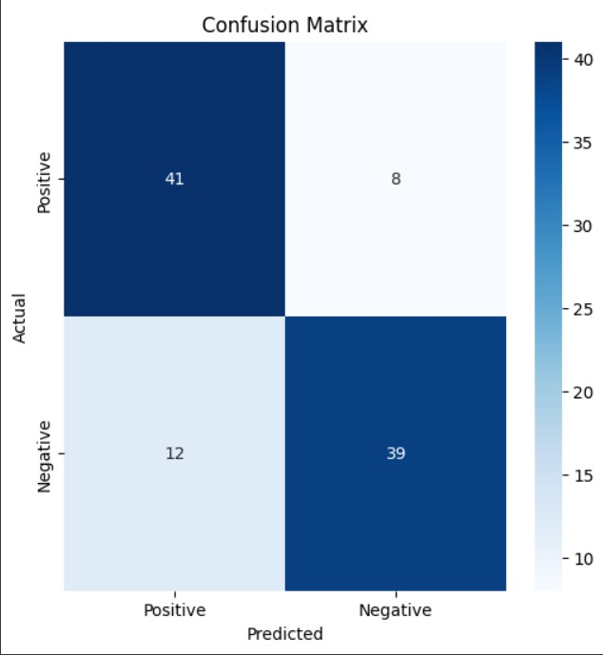
PIE CHARTS..

Slide 11
Summary
1. Understanding Audience Emotions-Sentiment analysis helps identify how audiences feel about a movie — whether they love it, hate it, or feel neutral.
2. Saves Time and Effort-Manually reading thousands of reviews is impossible.
Sentiment analysis automates this process, giving quick overviews and trends in minutes.
3. Useful for Decision-Making-Studios, marketers, and streaming platforms can use this data to:
Improve future content
Tailor marketing campaigns
Recommend movies based on mood or themes
4. Enhances User Experience-Recommendation systems become smarter and more personalized.
Viewers can get movie suggestions that match their tastes and emotional preferences.
5. Expanding Use in Industry-This technique isn’t just for movies. It’s also used in:
Product reviews
Social media monitoring
Brand analysis
Customer feedback analysis

Slide 12

Thank you

